Slide 1
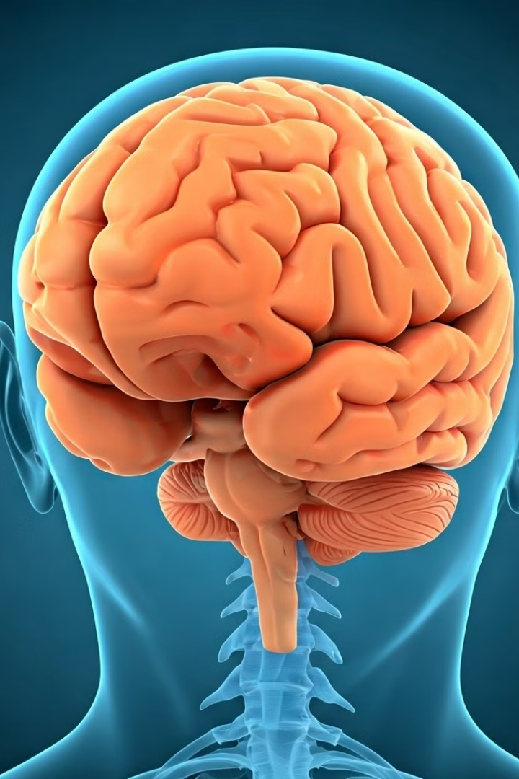
Brain Tumor Classification
Presentation by :
Mohab Ali.
Mohamed Khaled.
Mahmoud Ayman.
Supervised by :
Aya Hesham.

Slide 2


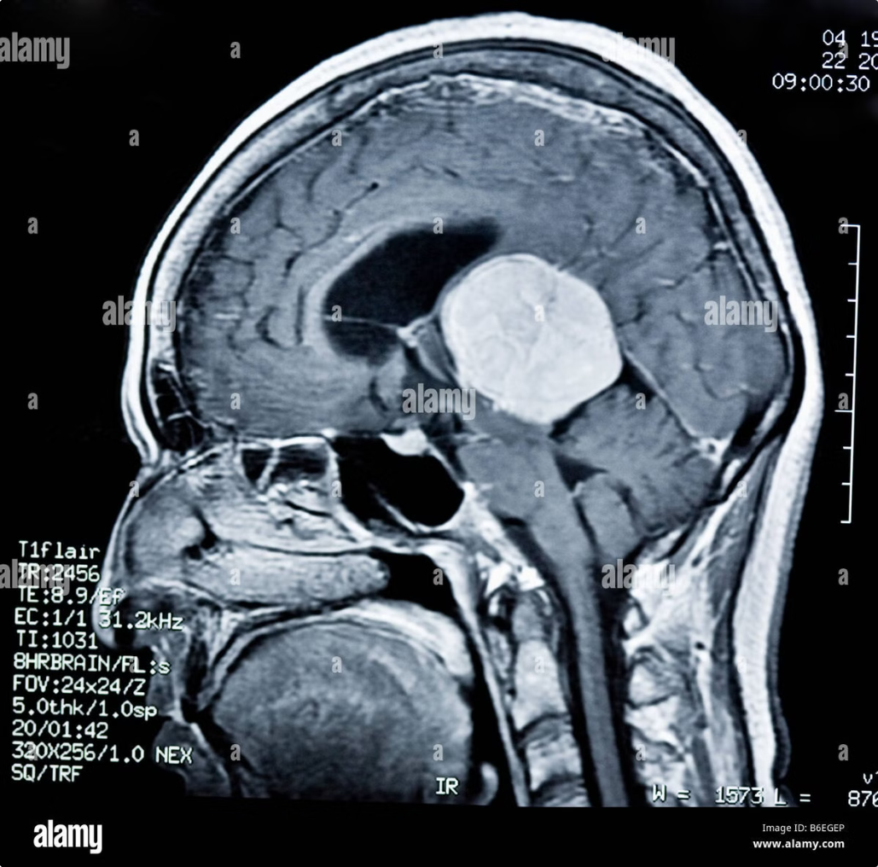

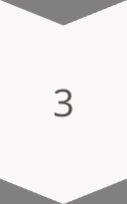
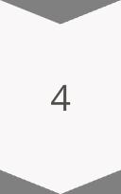
Problem Statement
Topic
Brain Tumor Classification using MRI Images
Importance
Early detection is crucial for appropriate treatment
Problem
Manual MRI classification takes alot of time and can lead to error
Goal
Classify tumors into four categories using machine learning

Slide 3
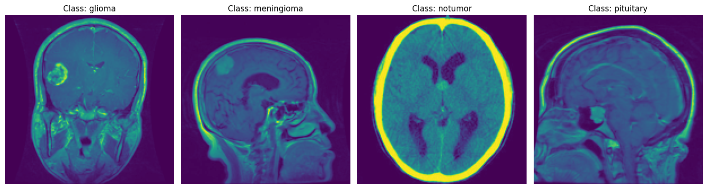
Dataset Overview
Size
7,023 brain MRI images
Classes
Glioma, Meningioma, No Tumor, Pituitary Tumor
Source
Kaggle's Brain Tumor dataset
Shape
Various dimensions, pre-processed and resized

Slide 4
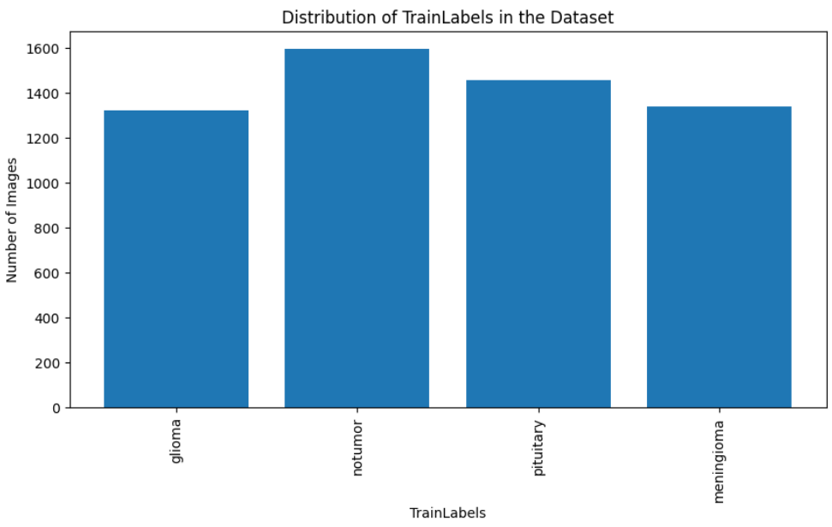
Dataset : Training
Glioma
1,321 brain MRI images
Meningioma
1,339 brain MRI images
No Tumor
1,595 brain MRI images
Pituitary Tumor
1,457 brain MRI images
Total
5,712 brain MRI images

Slide 5
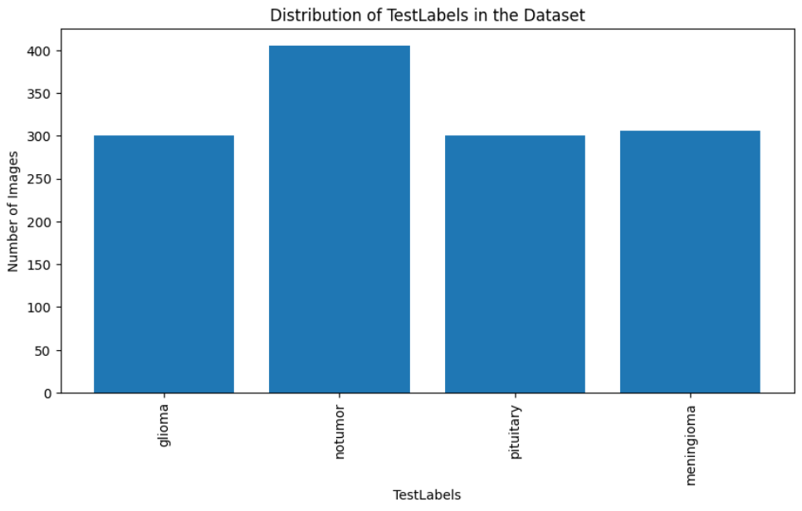
Dataset : Testing
Glioma
300 brain MRI images
Meningioma
306 brain MRI images
No Tumor
405 brain MRI images
Pituitary Tumor
300 brain MRI images
Total
1,311 brain MRI images

Slide 6
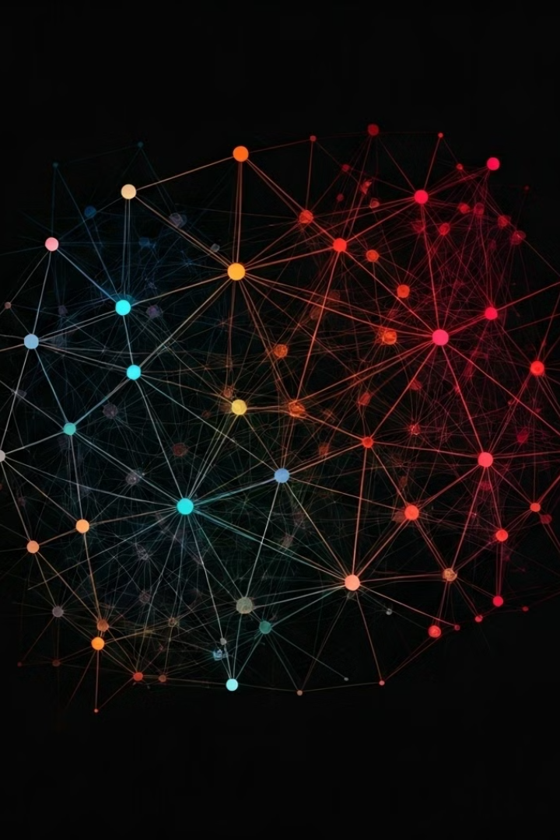
Approach
Pre-Processing
Splitting
Model selection
Training
Evaluate
Deploy

Slide 7




Team Roles
Mohamed Khaled
Data preprocessing and augmentation
Mohab Ali
CNN architecture design and training
Mahmoud Ayman
Model deployment and performance tuning

Slide 8
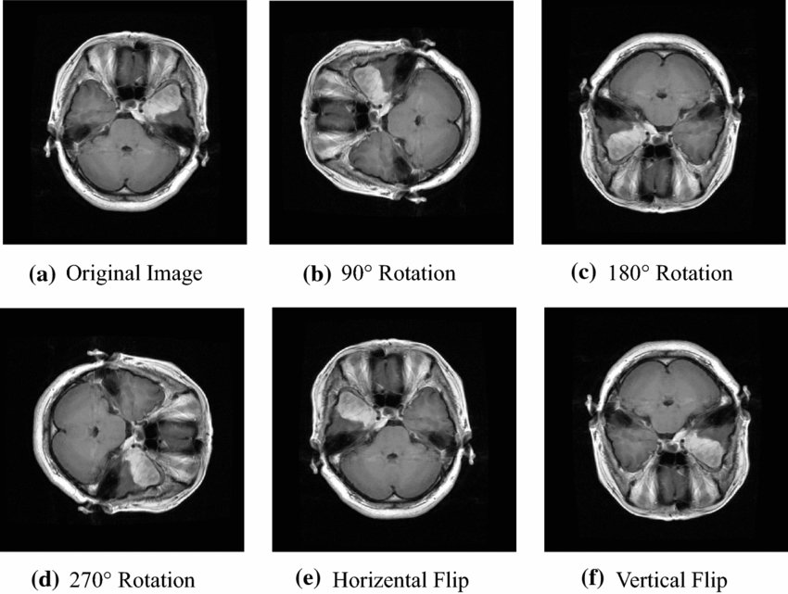
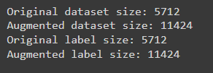
Pre-processing
Data Augmentation

Slide 9
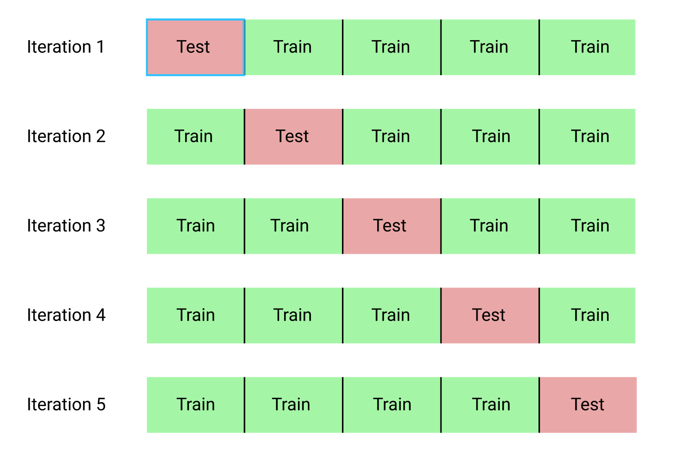
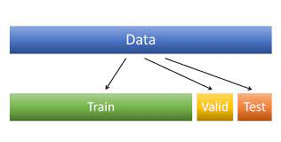
Data Splitting
K-fold
Train Validation Split
Test

Slide 10
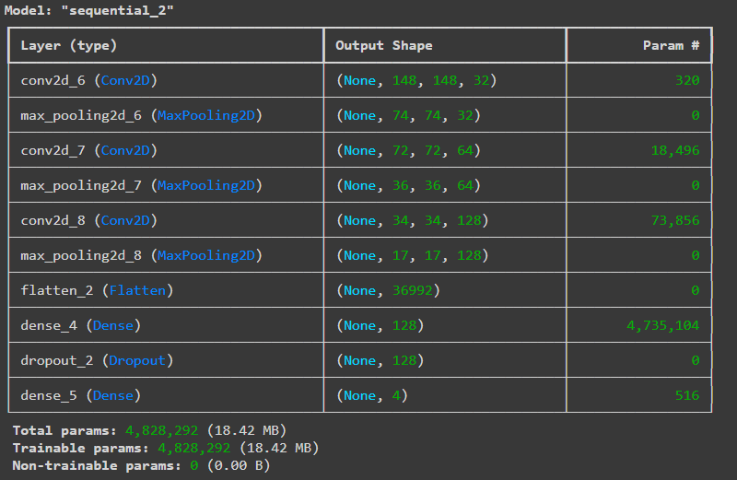
Model
Model
CNN-based multi-task approach
Task
Tumor detection and classification by type

Slide 11
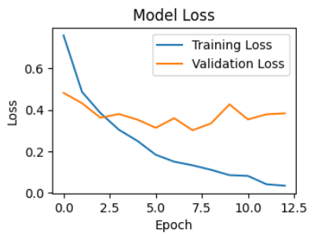
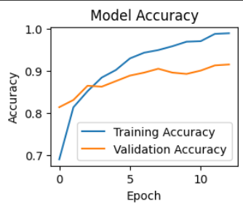
Viualization

Slide 12
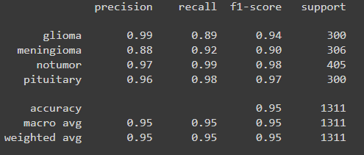
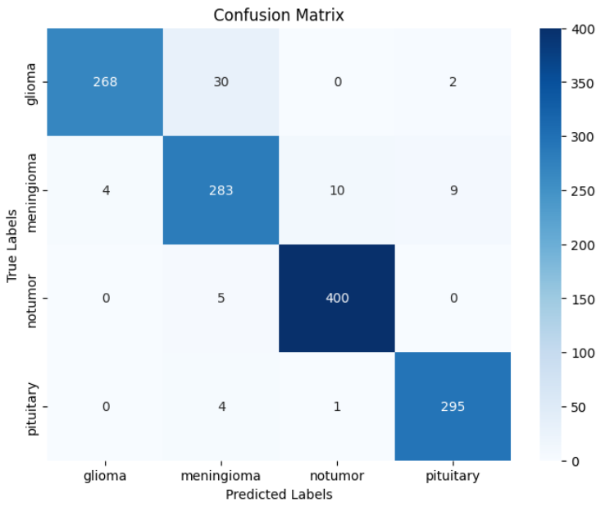
Model Evaluation
Model performance in tumor detection
97%
Model performance in tumor classification
95%

Slide 13
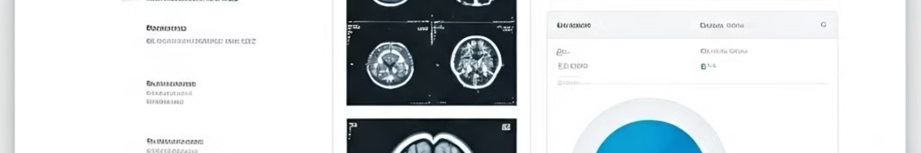
Deployment Methodology
1
Platform
Deployed using Gradio
2
Model as a Service
MRI image classification application
3
Integration
Seamless incorporation into existing medical systems

Slide 14
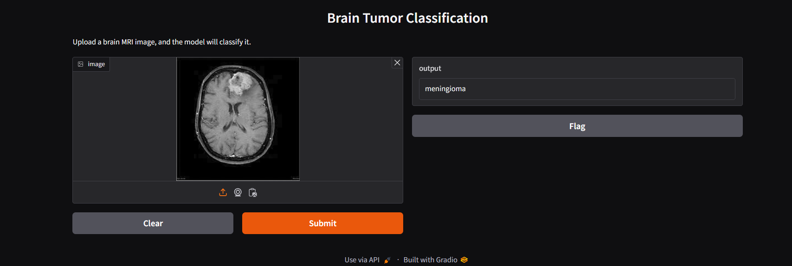
Live Demo Preparation

Slide 15
Questions?

